Slide 1



Resurrecting the State Highway Logs
GIS-T 2022
April 22
11:00 - 11:30
Sage Donaldson
ADOT
Data Analytics and HPMS Program Manager
John Ehlen
Gistic Research, Inc
GIS Project Manager

Slide 2
Background
ADOT 30-year tradition of State Highway Log Publication
Summary Log (by District / Org)
CL - Centerline Miles
LM - Lane Miles
MTLM - Maintenance Lane Miles
Detail Log
Asset inventory along DOT-maintained routes
Interrupted in 2014 with the Esri R&H implementation
Notes:
Highway log produced annual until 2014. The State highway lof details the mileage by route and total, pavement surface type, shoulder lanes, number of lanes miles. The summary details mileage by CL, LM and MTLM as well as districts and counties. The details log includes the asset inventory like pavement surface type.

Slide 3
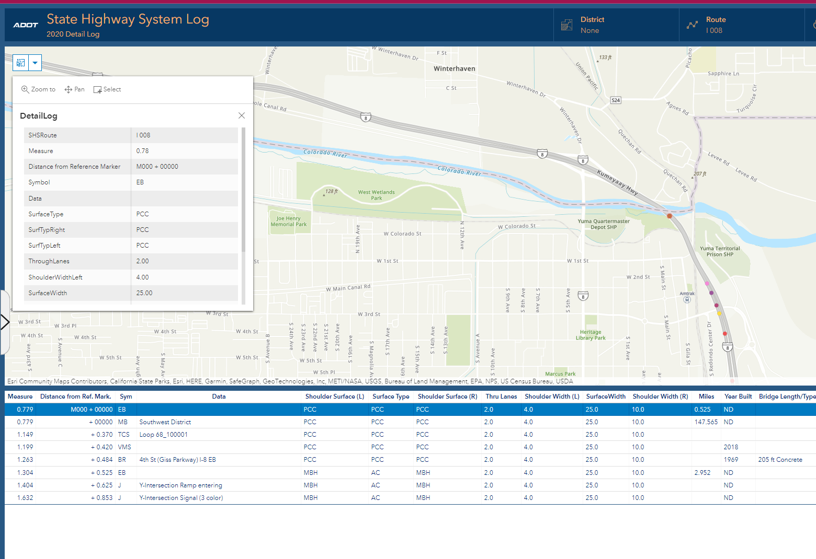
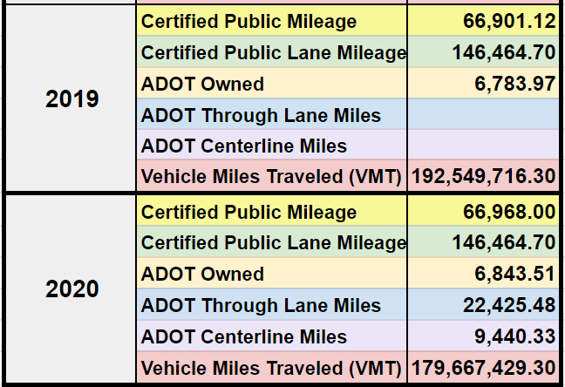
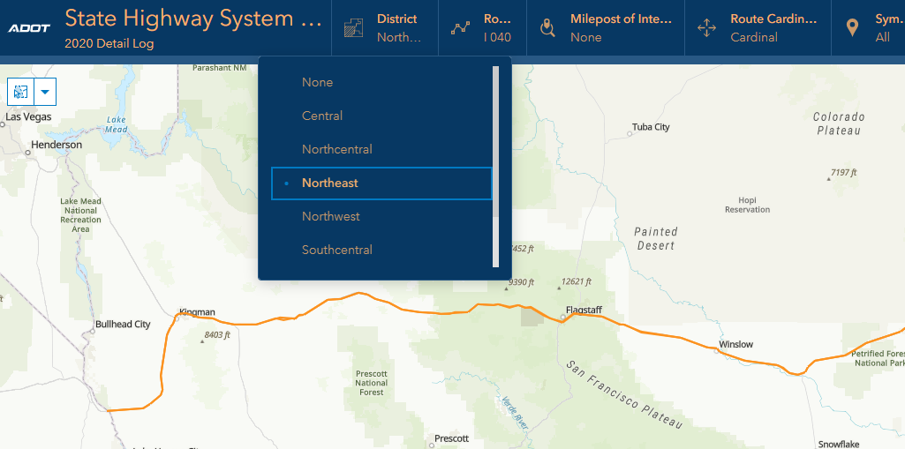
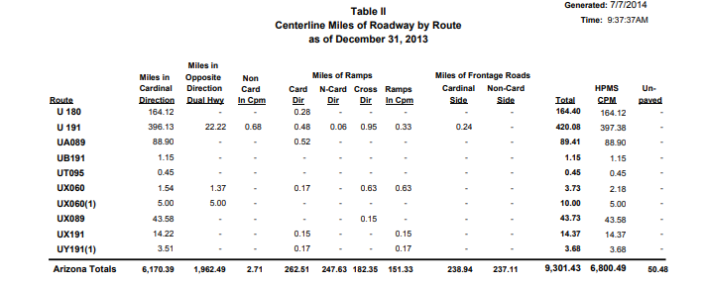
ADOT Usage
Mileage Summaries
Detailing Project History
Roadway Inventory
District Summaries
Notes:
sage

Slide 4
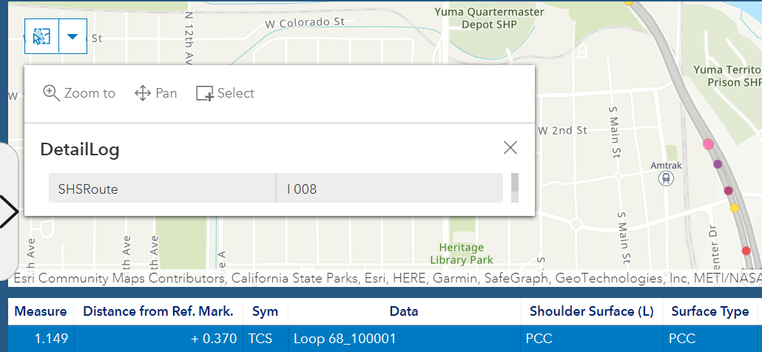
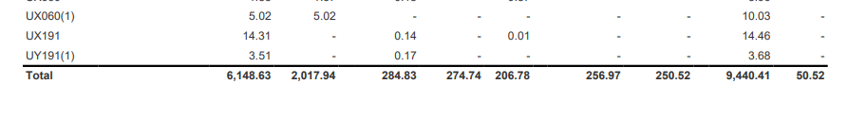
Data Decision making with SHS Log
Budget Items to the Legislature
Historical Comparisons
Growth projections
Construction Management
2013 Highway Log
2020 Highway Log

Slide 5
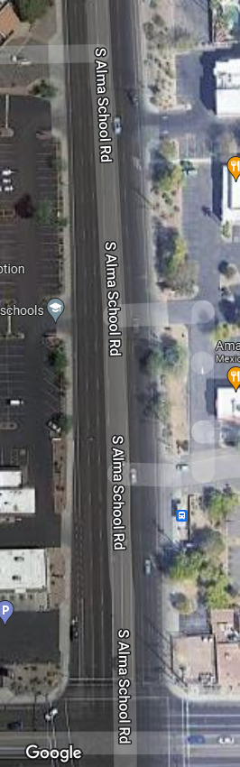
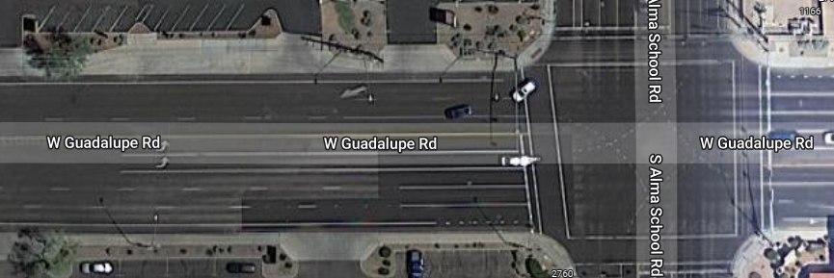
Understanding Components of the Highway Log
Centerline Miles:
  Total Length
Lane Miles:
  Through lanes x segment length (miles)
Travel Lane Miles:
  Through lanes, turn lanes, auxiliary lanes, passing lanes x segment length (miles)
Maintenance Lane Miles:
  Through lanes, turn lanes, auxiliary lanes, passing lanes, shoulders x segment length (miles)
X
Number of Lanes
Centerline
0.5 Centerline Miles
X
Centerline
X
Centerline
Notes:
sage

Slide 6
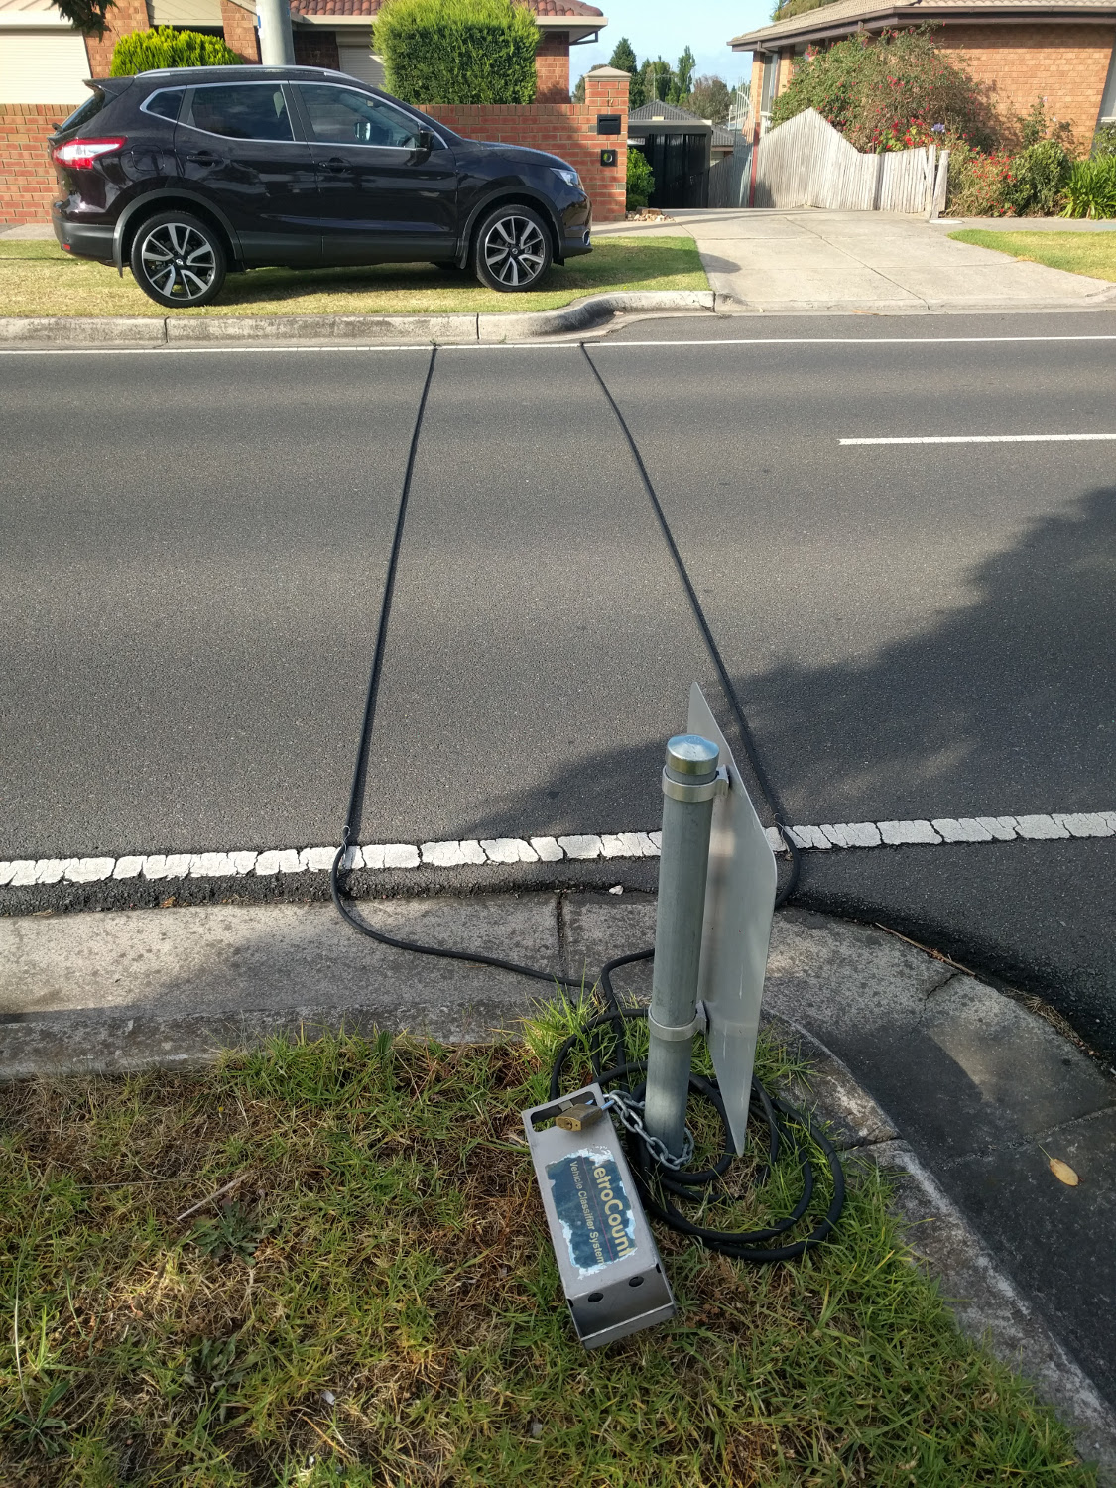
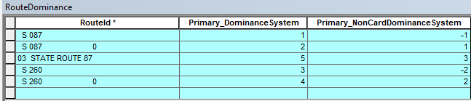
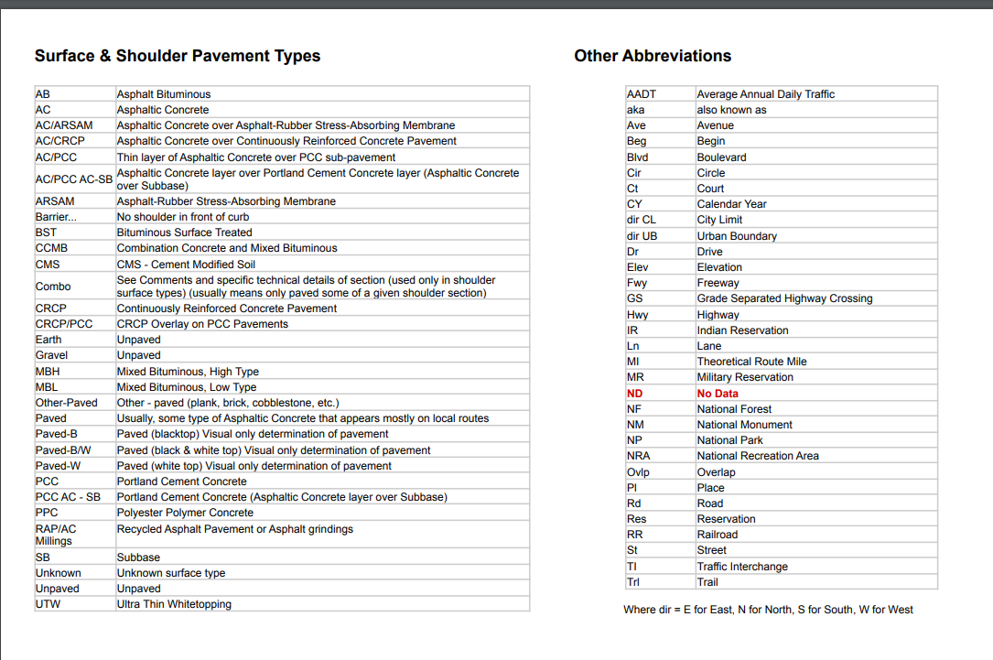
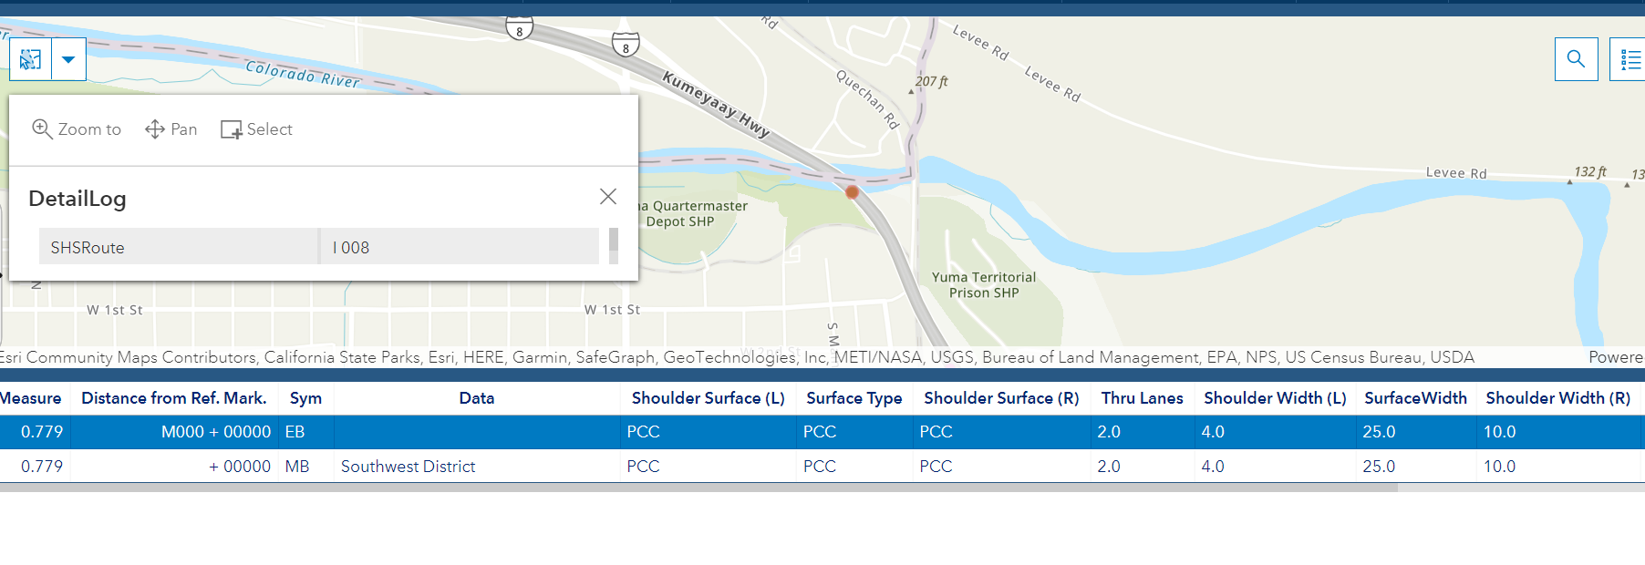
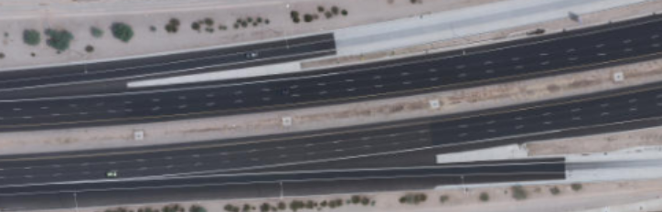
Understanding Components of the Highway Log Con’t
Route Dominance
Auxiliary Lanes
Asset Inventory
Pavement Type
Traffic Counts
Acronym Glossary
Notes:
Route Dom: Multiple route names on locally owned roads on the same geometry
Aux Lane: portion of the roadway adjoining the traveled way for speed change, turning, weaving, truck climbing, maneuvering of entering and leaving traffic

Slide 7
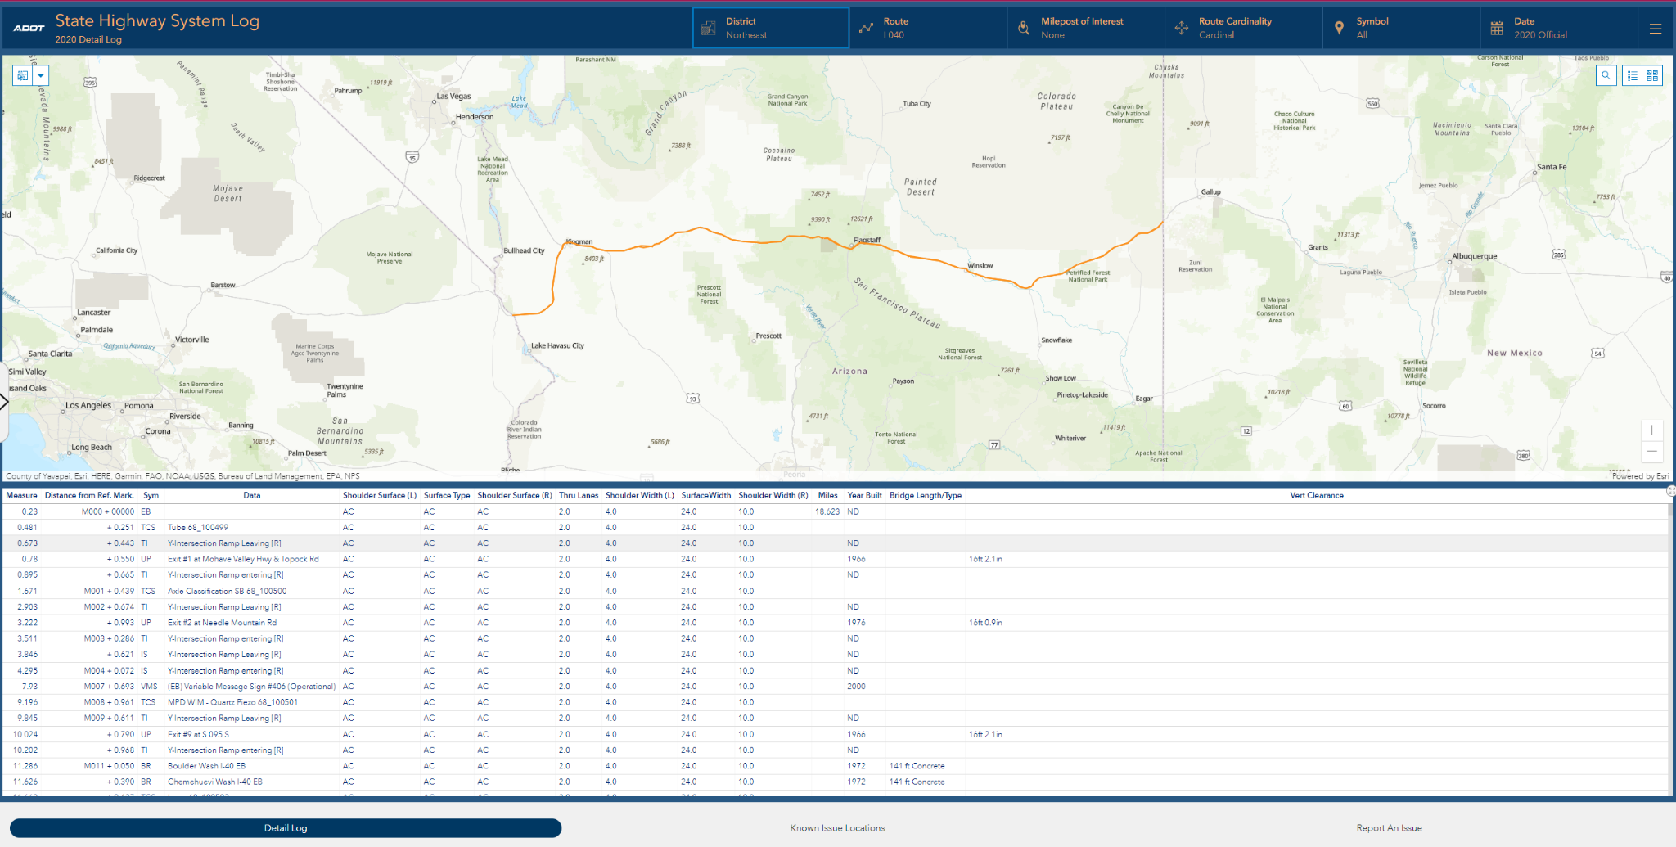
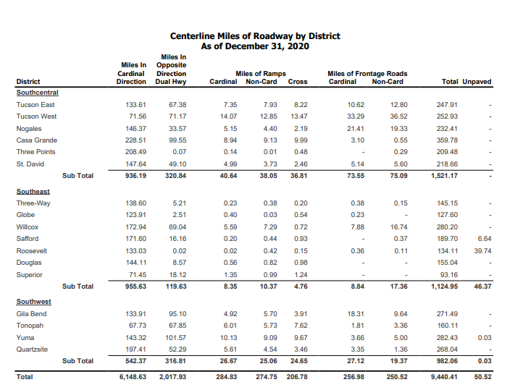
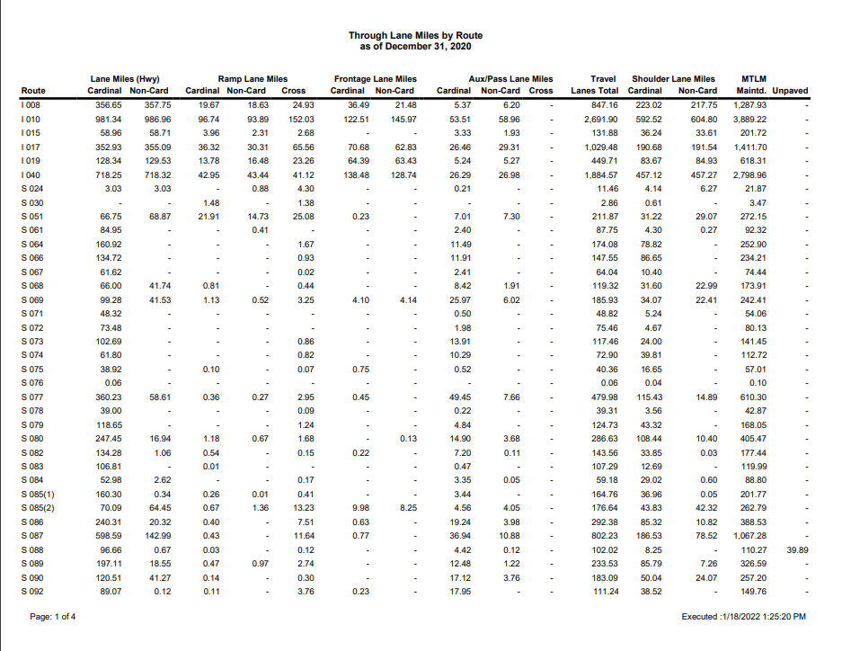
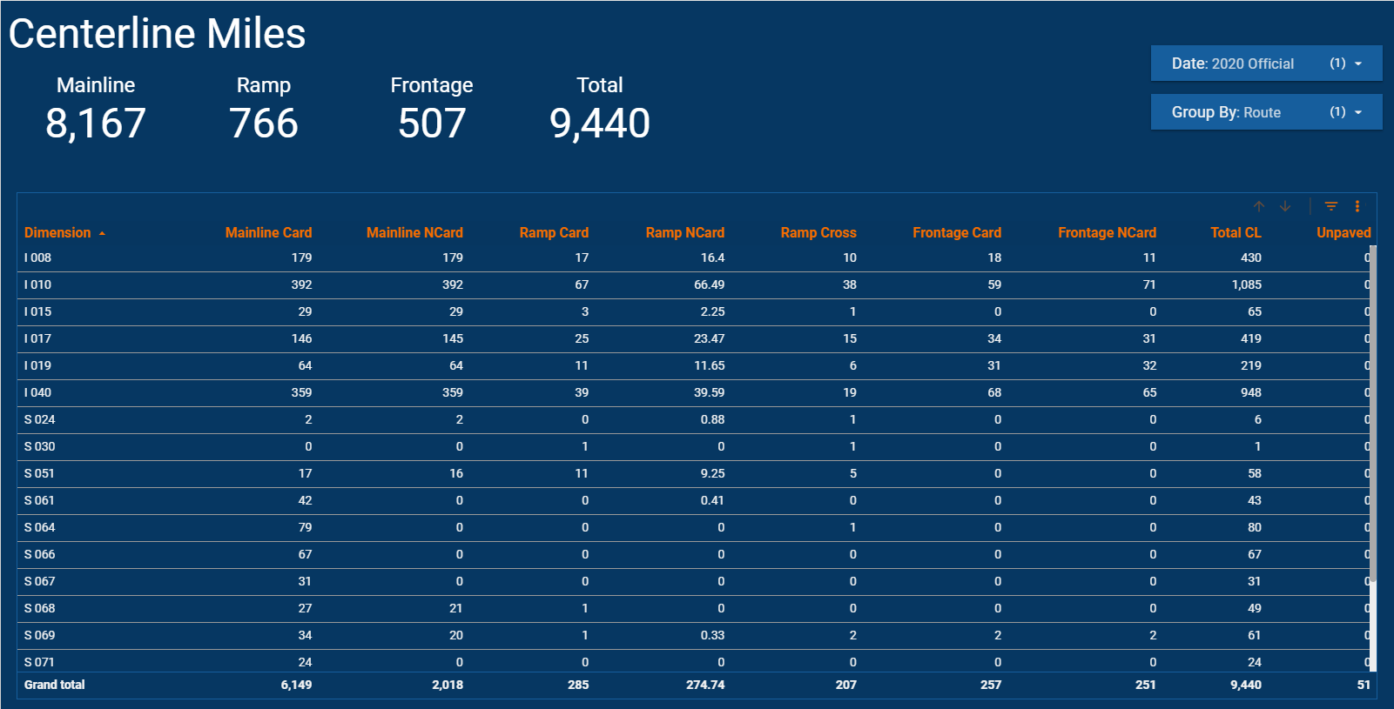
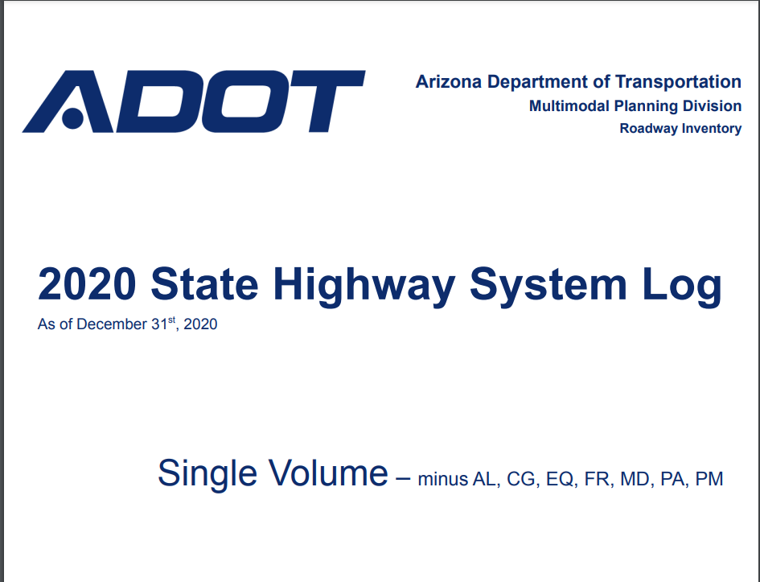
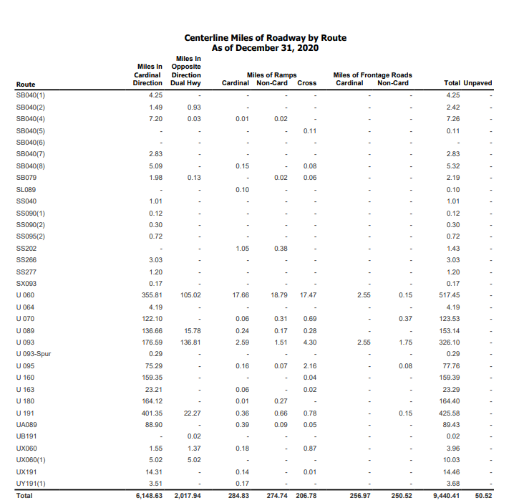
Current Version of SHS Log
Notes:
Sage
Share summary and detail and then move into how its made
Dashboard

Slide 8
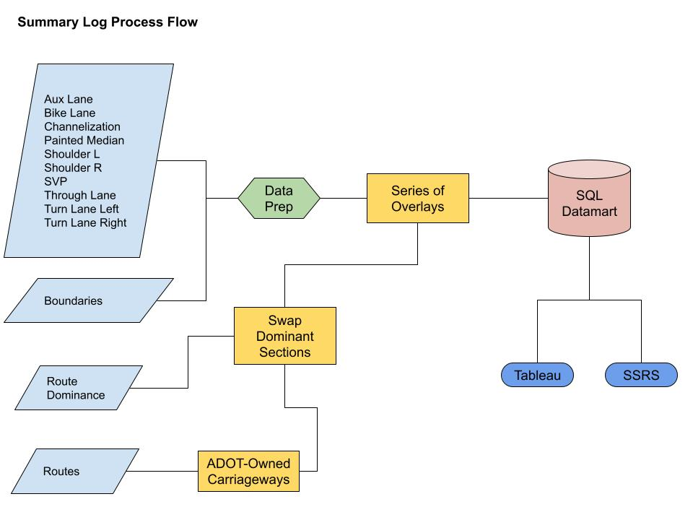
Summary Log Process Flow
Relatively simple process:
17 Data Source Inputs
290 Transformers
Output:
480 records
Writes to Nonspatial SQL Table
Notes:
Compared to the detail log, the summary log process is pretty straightforward. It performs a series of overlays on 17 feature classes, the output of which allows us to calculate the sum of centerlane miles, lane miles, auxiliary lane miles (including shoulders and bike lanes), and maintenance lane miles aggregated by route, engineering district, county boundary, and federal land ownership. This process spits out 480 nonspatial records into a SQL table. This SQL table is then used to populate a SQL Server report within Microsoft Report Builder and a Google Sheet for use in a Data Studio dashboard product shared internally at ADOT. Both offer a self-serve platform for users, who may dial in to the dimensions they need information about. The SSRS platform also allows for the generation of PDF reports, for people who want a paper version.

Slide 9
Summary Log Architecture
Google Data Studio Dashboard
Google Sheets
Lookup Tables / External Data
FME Translation
Event Layers
Roads and Highways
Notes:
Roads and Highways -> extract event layers -> Translate with FME using lookup tables and external data sources -> Google Sheet -> Google Data Studio

Slide 10
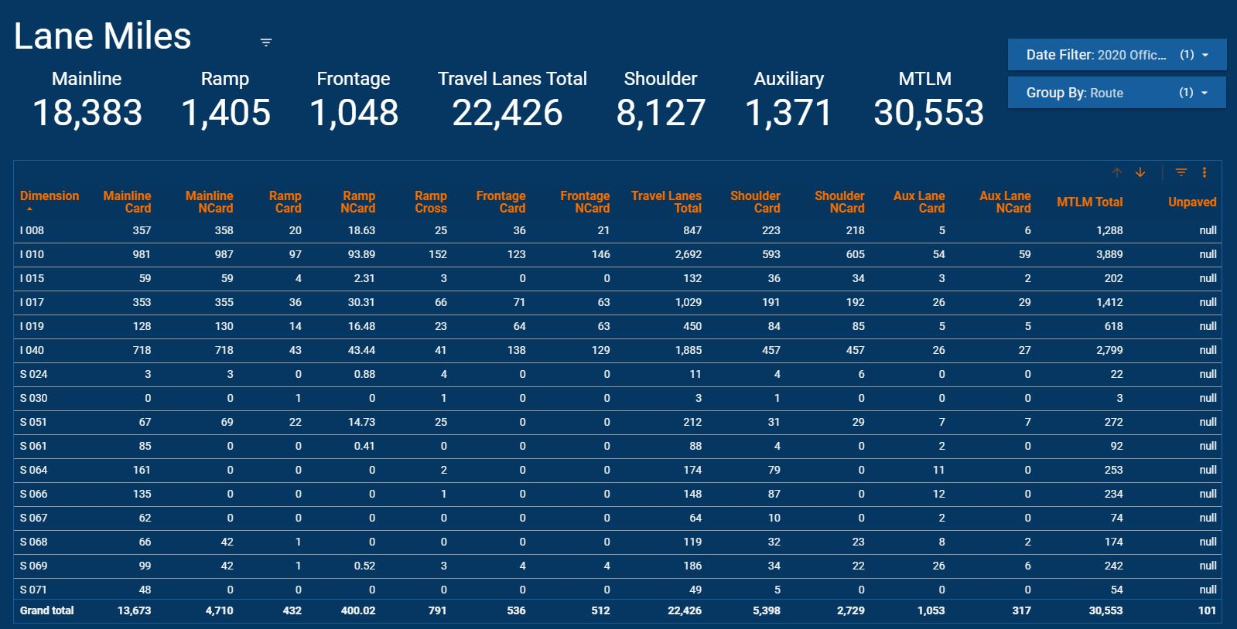
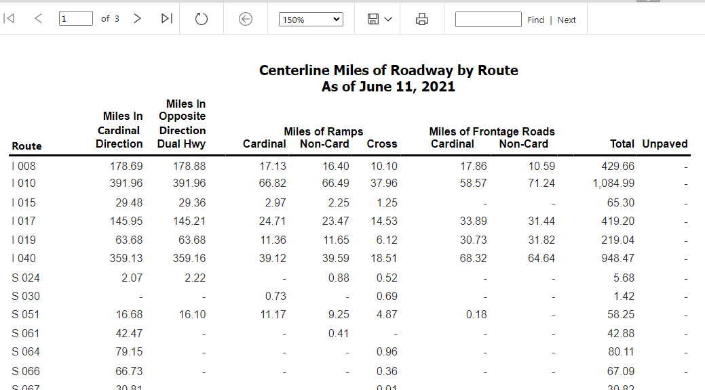
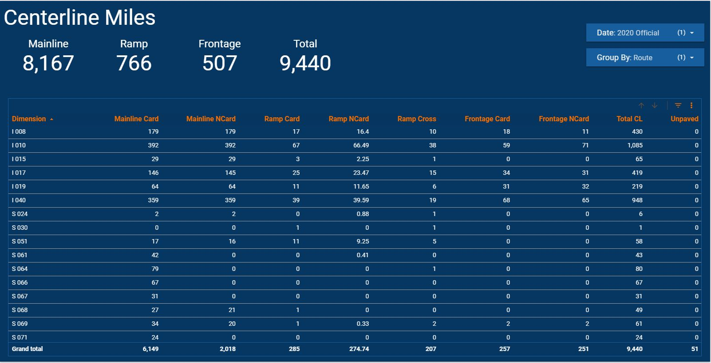
Summary Log Process Output
Notes:
>>This is the final product. This is a screenshot of the centerline miles google data studio dashboard. The users may use the ‘Group by’ dropdown to choose the dimension displayed.
>>The Lane Miles dashboard follows the same graphic themes, but displays lane miles by Mainline, Frontage, Ramp, Shoulder, Auxiliary, and maintenance
>>And this is what the SSRS report looks like on the server.

Slide 11
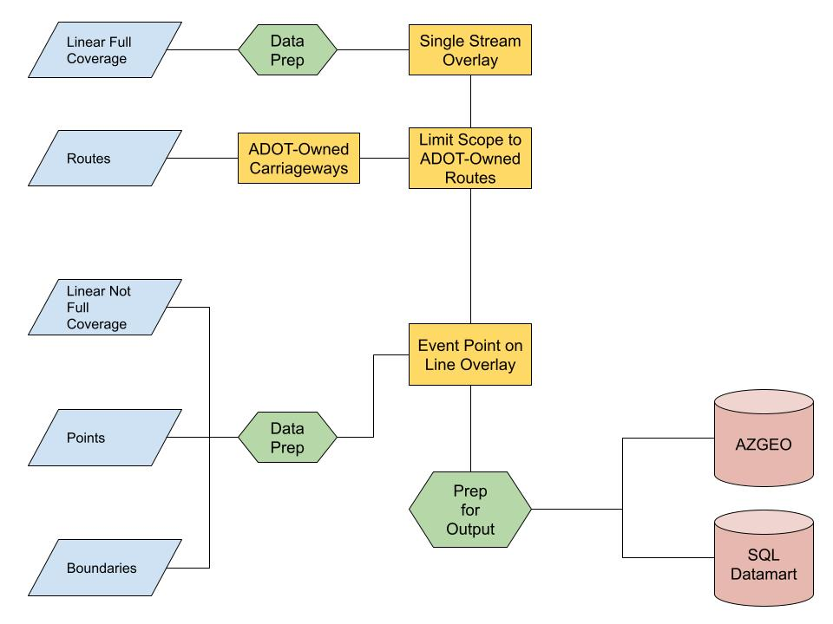
Detail Log Process Flow
Not Simple:
25 Data Inputs
318 Transformers
Output:
~41,000 records
Writes to AGOL and SQL
Notes:
Now I’d like to talk to you about the detail log process. This process is much more complex in every regard. It reads 25 data sources. 23 of those are shapefiles or feature classes and 2 of them are flat lookup tables. It uses over 300 transformers to generate about 40,000 records that are written both to ArcGIS Online and a SQL table. The output is then consumed by SSRS and displayed in an Esri dashboard, which is nested inside an Experience Builder.
This flowchart illustrates the process flow. First, we do an overlay of all linear full coverage events with ADOT-owned routes to define the scope of the process. Then we convert the linear events that are not full coverage and polygonal boundaries to points with length attributes, mix those in with the point feature classes, and do an event point on line overlay with the output of the previous overlay process. Then we tidy that output and write to the AZGEO ArcGIS Online feature service and our SQL database.

Slide 12
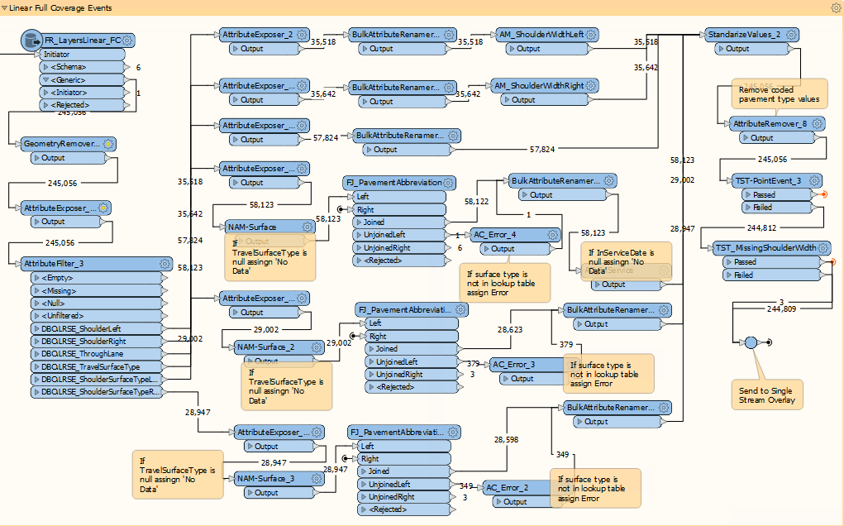
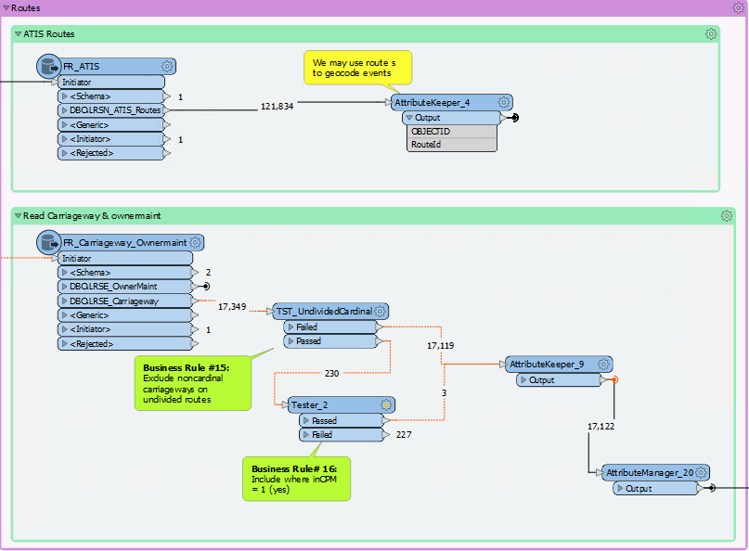
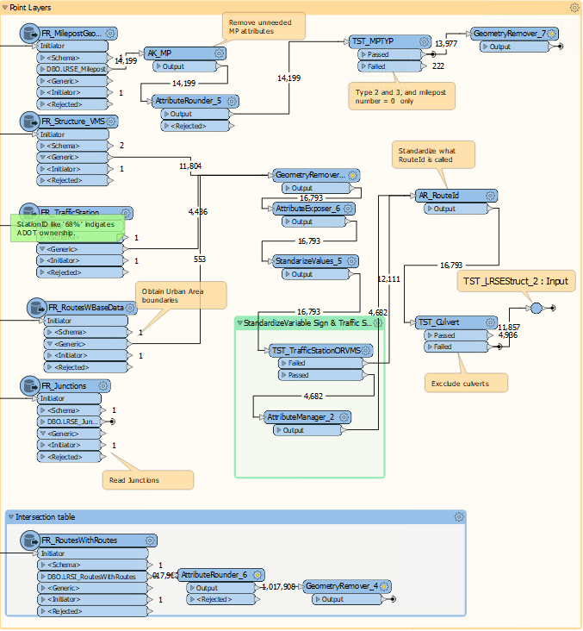
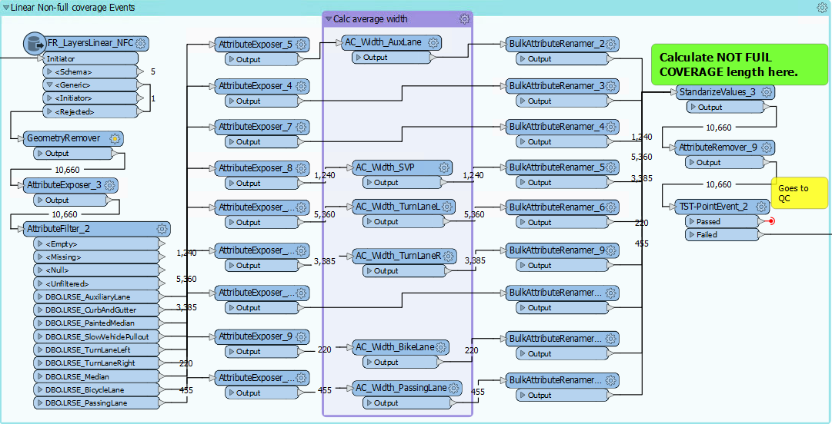
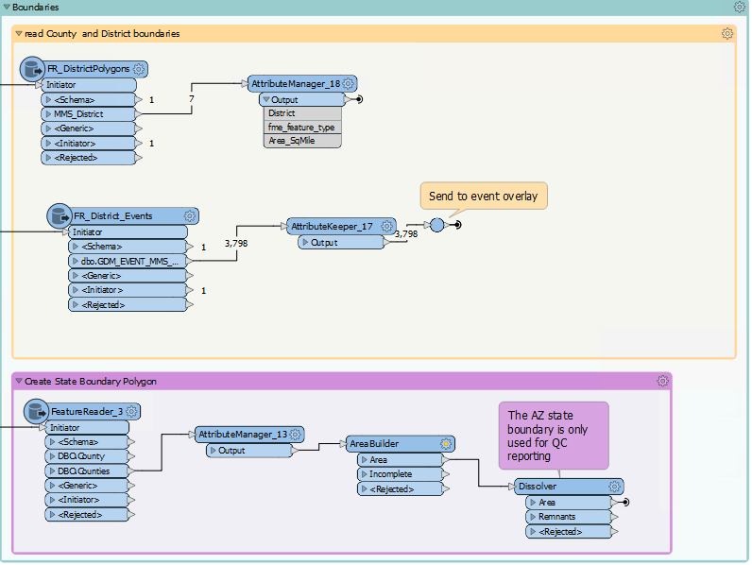
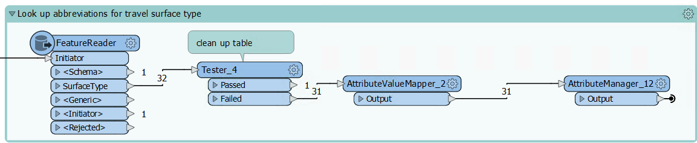
Detail Log Process Flow: Read and Standardize
Notes:
As illustrated in the flow chart on the previous slide, the data read into this process falls into 6 categories:
Linear, full-coverage feature classes
Linear, not-full-coverage feature classes
Point layers
Route network, including Carriageway descriptors and ownership
Boundaries, including polygonal and event layers
Lookup tables to enhance domains
For each input group, the data is read and the columns are standardized in preparation for the next processing steps.

Slide 13
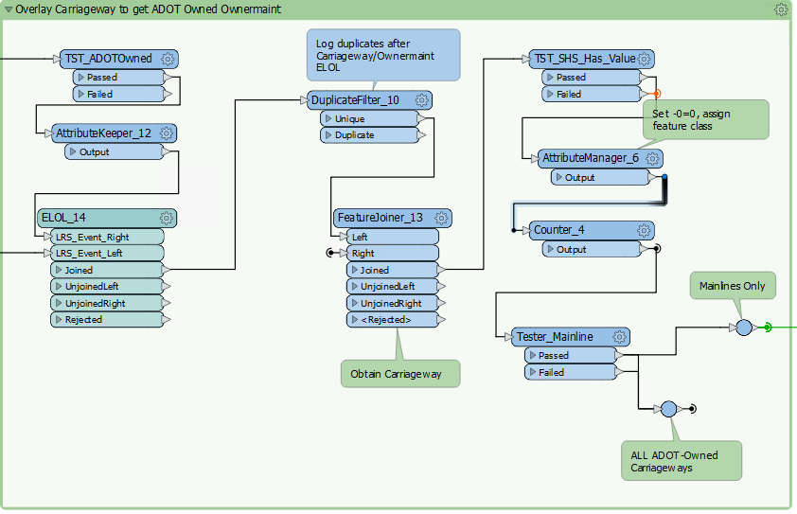
Detail Log Process Flow
Overlay to define scope
Notes:
ADOT’s carriageway feature class includes important information including cardinality, route type, such as mainline, ramp, or frontage, as well as shortened route names that are much easier to digest than their standard 32-character routeid. However, this feature class covers highways and local routes, regardless of route ownership. To find ADOT-owned carriageways, we do an event overlay with ADOT-owned routes from the ownership layer. All data in the detail log is overlaid with these ADOT-owned routes, to limit the output to the scope of the detail log.

Slide 14
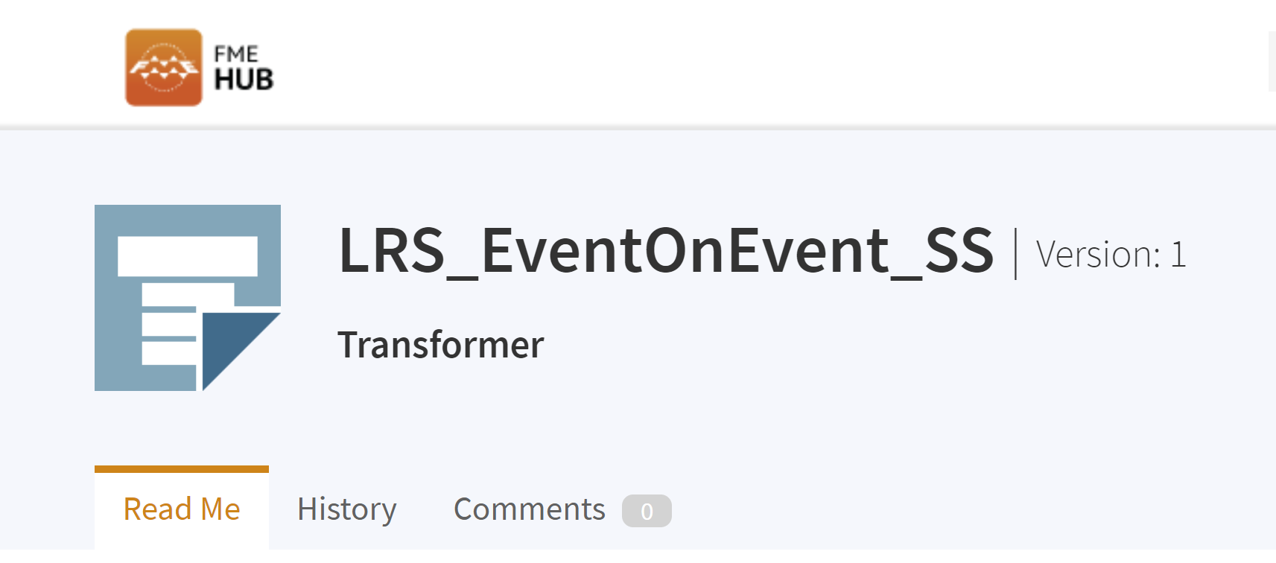
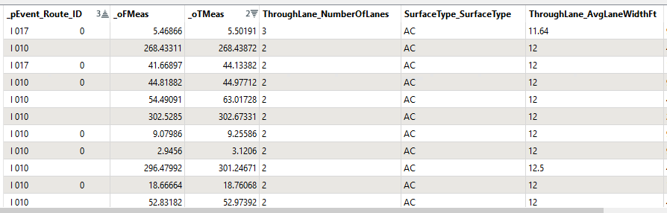
Detail Log Process Flow: Full Coverage Events
Notes:
If a feature class has full coverage, meaning it covers the entire route network, we combine all records into one stream. First, we standardize the columns in the data stream then send the entire stream to an overlay process where the stream overlays with itself. We call this a ‘single stream overlay’.
>>
>>The resultant output is a series of events, where each event describes the shoulder surface, pavement type, number of through lanes, shoulder width, surface width, and the length of that event. This screen shot is only a tiny sampling of the output of this massive overlay of 6 feature classes.

Slide 15
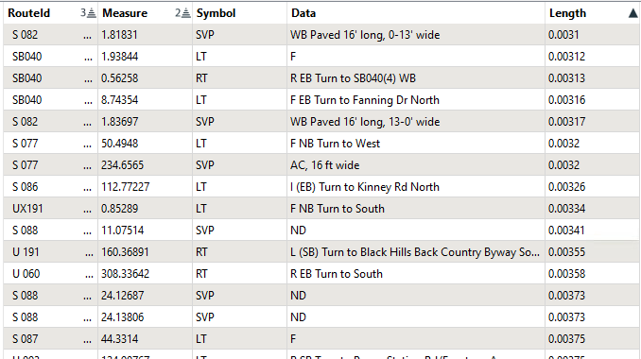
Detail Log Process Flow: Lines Events as Points
Notes:
I mentioned this on a previous slide - we pull a bit of an interesting manipulation in this process. Every data source that is not a full coverage event feature class is treated as a point. We convert lines and polygons to points, and throw them into the event point on line overlay process with the true point feature classes. This works because we capture the length of each event, so when it is displayed in the output the linear or polygonal point has a measure and a length.
This table illustrates what the linear, non-full coverage events look like after being converted to points. The Symbol column is populated with a lookup table that gives an abbreviation for every source feature class name. Here we have slow vehicle pullout, left turn lane, right turn lane, left turn lane, etc. The data column describes the event with more textual information.

Slide 16
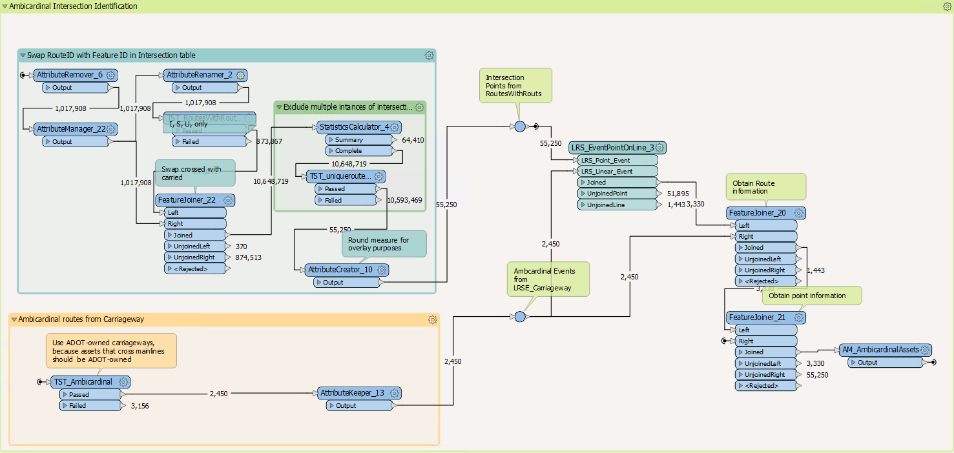
Detail Log Process Flow: Preparing Points for Overlay
Ambicardinal
Non-Cardinal
Junctions
Cardinal
Notes:
There are 6 feature classes with actual point geometry used in this process, 3 of which require some more involved processing. The most difficult of which is identifying where a road crosses both the cardinal and noncardinal sides of the mainline. ADOT calls these ambicardinal intersections.
The carriageway feature class tells us which routes are ambicardinal to the SHS routes that are displayed in the detail log. The problem is that the measures that identify these crossings are on the ambicardinal routes. But we need the measure on the mainline where the amicardinal route crosses! Well, the junction table contains the measures on both routes at these intersections.
>> So we swap the crossed measure and carried measure using the junction table, then we overlay that output with ADOT-owned ambicardinal routes. This output goes into the event point on line overlay.
The remaining point pre-processing steps are much more straightforward, so I won’t bore you with them.

Slide 17
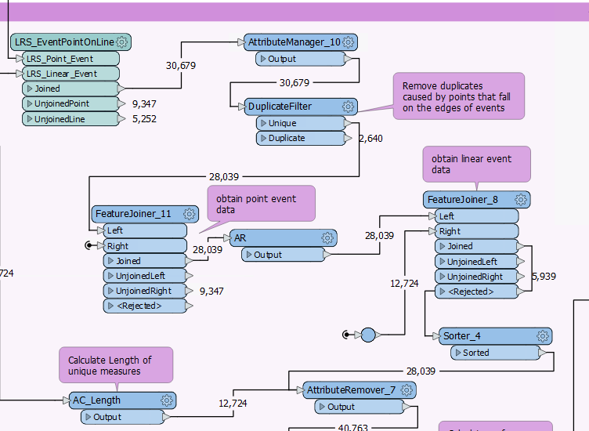
Detail Log Process Flow
Final Overlay
Notes:
Finally, all point streams are combined and the point stream goes into an Event Point on Line overlayer, where the point stream is overlaid with the linear full coverage event output of the single stream overlay process. The output of this part of process is event point format, with a measure and length value. We use a quick SQL script to obtain milepost and offset attribution and a bit of attribute cleanup such as deleting duplicate spaces caused by field concatenation. Now we have a detail log where every important asset on ADOT routes is marked with a point!

Slide 18
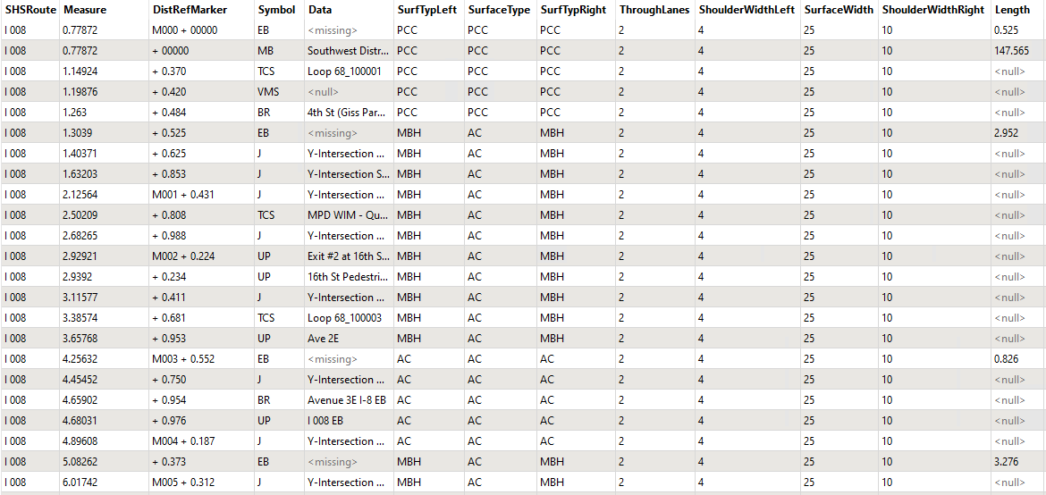
Detail Log Process Flow: SHS Log Output
Notes:
This screenshot illustrates the final attribute schema.
>>The various points, not-full coverage feature classes, and polygons are captured with the Symbol and Data columns.
>> Every segment of roadway contains these attributes that were derived from the full coverage feature classes.
>>The features that have null length values were derived from feature classes that have true point geometry.

Slide 19
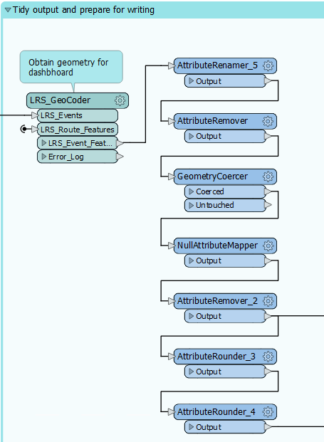
Detail Log Process Flow:
Prepare To Write Output
Notes:
At this stage of the process, the data is ready to write to the nonspatial SQL table.
However, our event points are nonspatial, so we geocode to obtain point event geometry, and we do a bit of tidying and standardizing before writing to the ArcGIS Online Feature Class.

Slide 20
Detail Log Architecture
ArcGIS Experience Builder
HTML/JS Web Page
ArcGIS Dashboard
ArcGIS Online Table
ArcGIS Survey123 App
ArcGIS Web Map
ArcGIS Online Table
Lookup Tables / External Data
FME Translation
Event Layers
Roads and Highways

Slide 21
Dashboard Demo
Highway Log: https://experience.arcgis.com/experience/c73df006de8040e19bc5c6950490ce27/
Summary Log: https://datastudio.google.com/u/3/reporting/b753c786-1340-4f19-bc9e-3688efffe267/page/p_9aux6bahnc
Metadata:
https://arcg.is/14zOHG0

